Slide 1


An examination of educational qualification on income among male and female graduates
By: Roy McPherson
Date: 2022

Slide 2


Statement of the problem
In Canada, women between 25 to 54 earned 13 % less per hour on average.
Despite women surpassing men in educational attainment in the country, the issue of income inequality persists.
Source: Statistics Canada, 2019

Slide 3

"What influence does one’s educational qualification have on income among male and female graduates?"

Slide 4
Summary highlight (1 of 2)
1. Males reported a higher mean median income when compared to females at all levels of education.
2. The differences in mean median income earned was most pronounced among those who had a professional degree.
3. All the differences between mean median income for each level of education was statistically significant, which means they did not occur by chance.

Slide 5
Summary highlight (2 of 2)
4. Higher incomes were mainly associated with those with a professional degree for both males and females.
5. There is progress towards a decrease in the mean median income gap for males and females at all levels of education as all differences were trending towards 0.

Slide 6






Slide 7
Data source
Median income employment of post-secondary graduates 2010-2015
Statistics Canada
Educational qualification
Year & sex
Field of study & no. of graduates

Slide 8
Variables of Interest
Sex
Median Income
Year
Educational qualification
The following variables were utilized to answer the research question:

Slide 9


Slide 10
Data cleaning (1 of 2)
1. The data was transformed from wide to long format, thus abiding by the principles of 'tidy data' where each row represents an observation, and each column represents a variable.
2. The new column headings were: "ID" (Identification number), "Education qualification", "Area of study", "Sex", "Year", "sum of graduates", and "sum of median income".

Slide 11
Data cleaning (2 of 2)
"Sex", "Education qualification," and "Area of study" were changed into factors.
All missing values were replaced with NA for ease of calculation and preparation of charts.

Slide 12
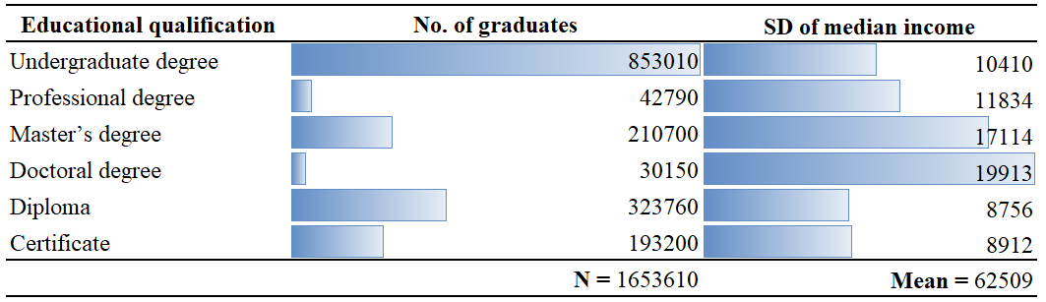
Analysis of findings (1 of 6)
Demographics
Figure 1: Number of graduates and standard deviation of median income by educational qualification
1. Those with a doctoral degree deviated the most from the mean when compared to other qualifications.

Slide 13
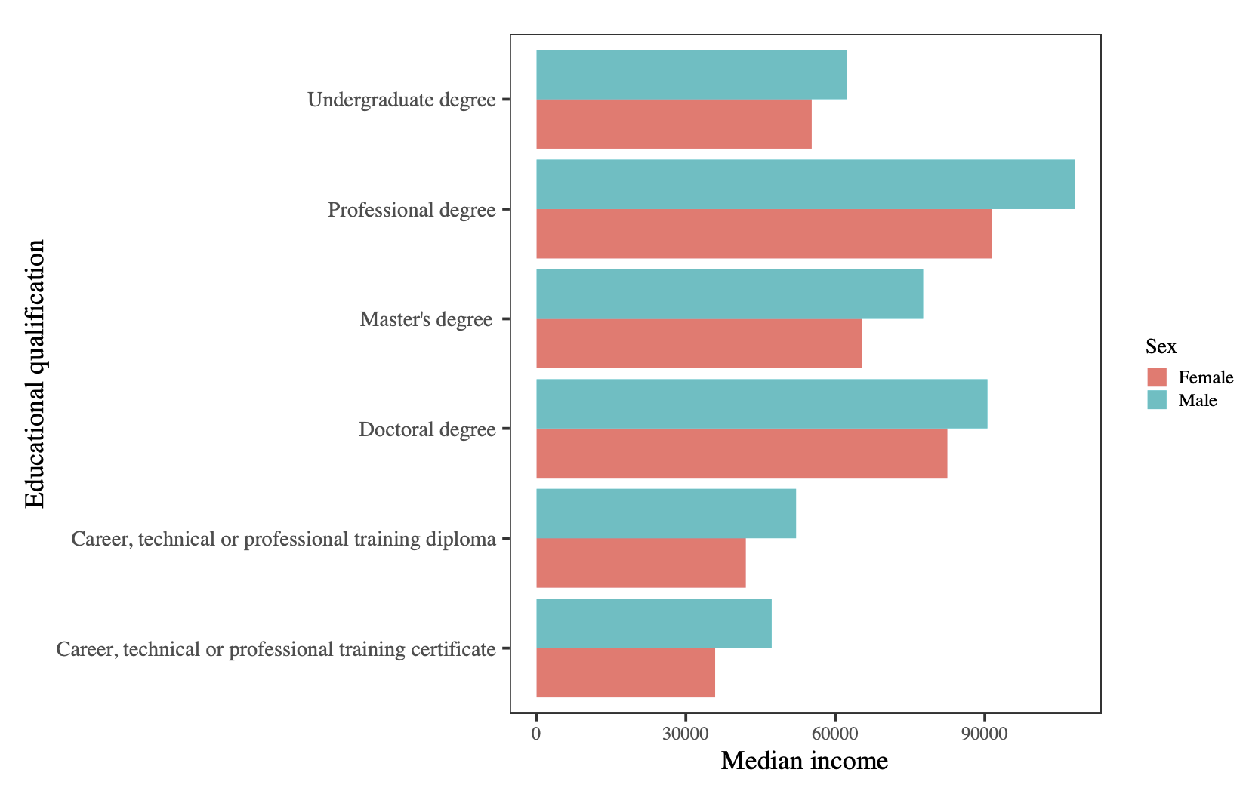
Bivariate and inferential analysis
Analysis of findings
(2 of 6)
Males reported a higher mean median income when compared to females.
Figure 2: Mean median income by sex and educational qualification

Slide 14
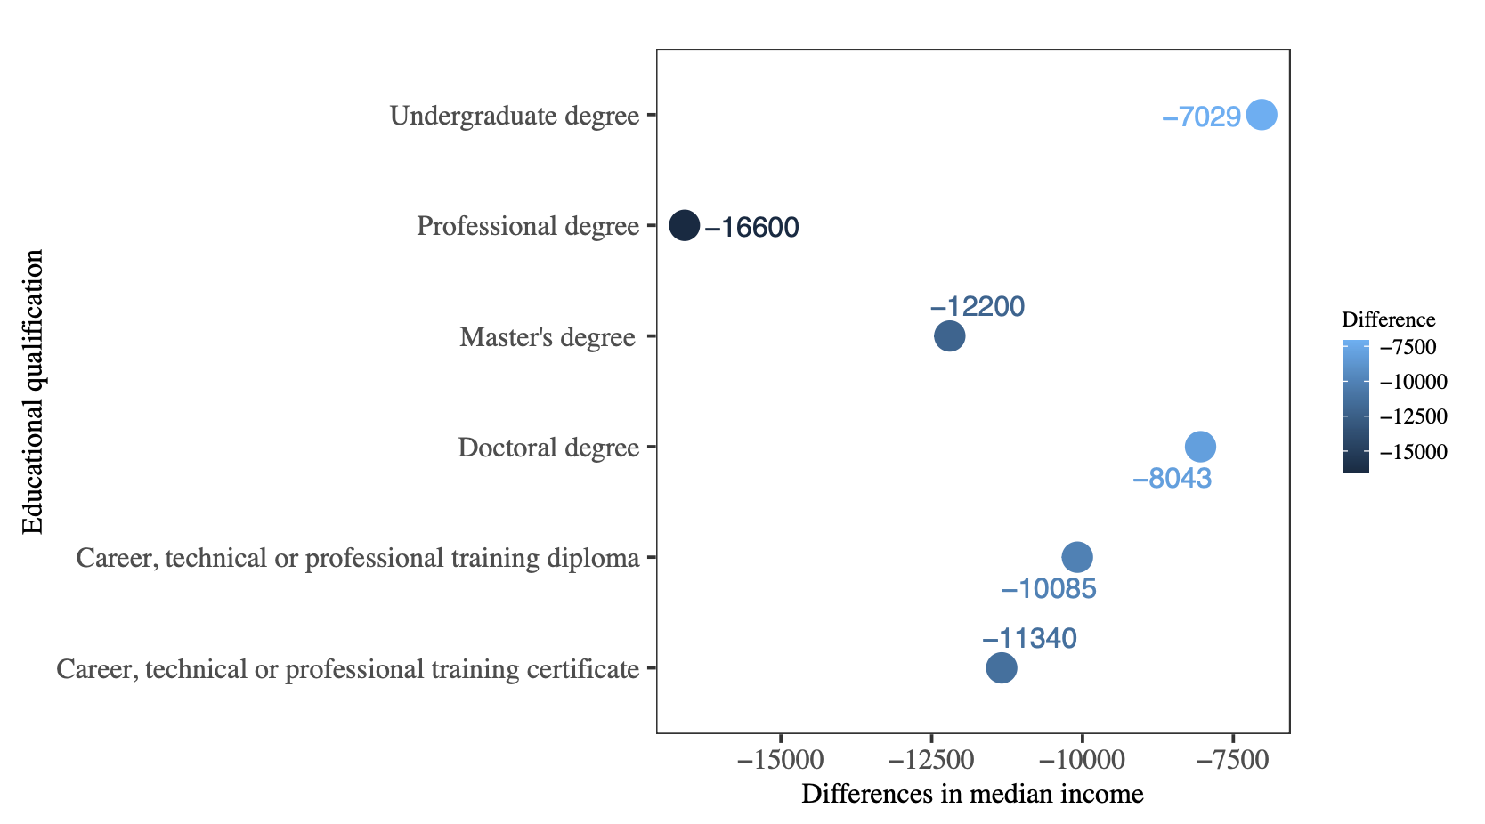
Analysis of findings (3 of 6)
Largest difference:
Females earned 16600 less than males.
Smallest difference:
Females earned 7029 less than males.
Figure 3: Mean median differences in income by educational qualification

Slide 15
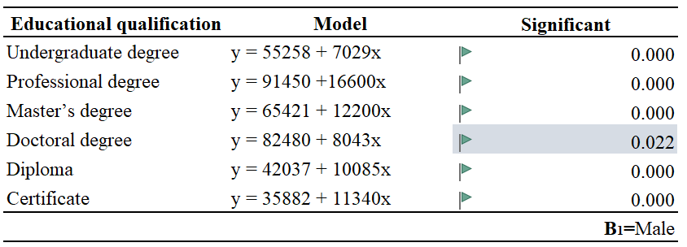
Analysis of findings (4 of 6)
The results provide statistical evidence that there was a significant difference for all levels of education.
Figure 4: Regression models on the mean median income differences by sex and educational qualification

Slide 16
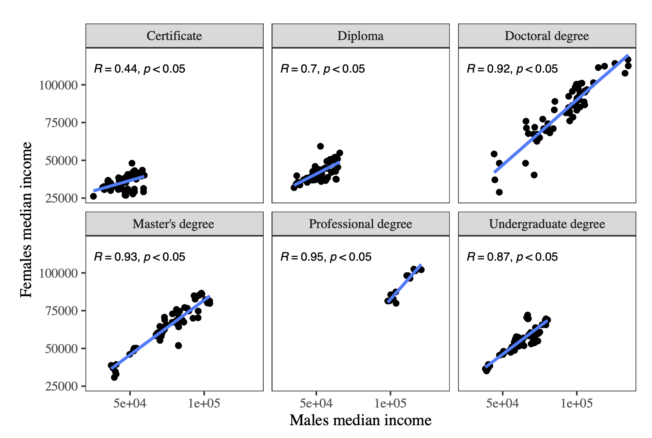
Analysis of findings (5 of 6)
The strongest association seen among those with professional degrees, in that, as median income for males increased, median income for females also increased (r = 0.95).
Figure 5: Linear regression of male and female median income by educational qualification

Slide 17
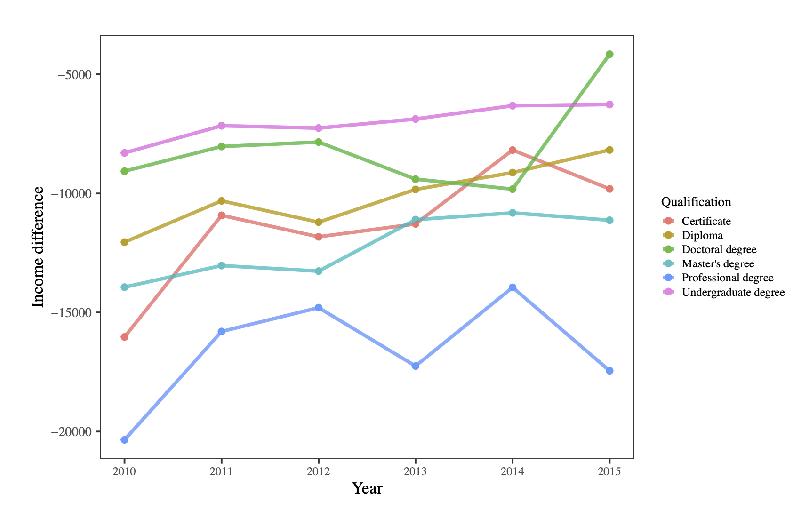
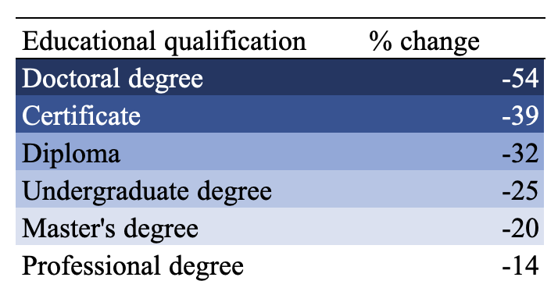
Analysis of findings (6 of 6)
Figure 6: Mean median income differences by education qualification and year
There is progress towards a decrease in the mean median income gap for males and females at all levels of education as all differences were trending towards 0.

Slide 18
Conclusion (1 of 2)
1. Males reported a higher mean median income when compared to females at all levels of education.
2. The differences in mean median income earned was most pronounced among those who had a professional degree with females earning 16600 less than their male counterpart.
3. All the differences between mean median income for each level of education was statistically significant, which means they did not occur by chance.

Slide 19
Conclusion (2 of 2)
4. The strongest association of median income between sexes was seen among those with professional degrees.
5. There is an overall decrease in the mean median income gap for all educational levels. More pronounced with those with a doctoral degree.

Slide 20
Limitation
One of the main limitations of the study is the period of interest was limited to five years, 2010-2015.
Future studies could also focus on variables such as immigration status and race.

Slide 21

Questions

